Slide 1


Slide 2

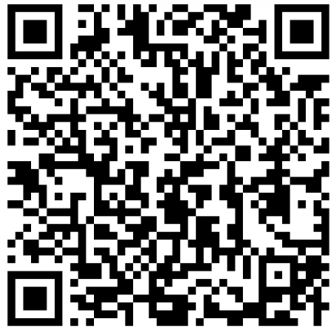
Building Thinking Classrooms in a Senior Class

Slide 3
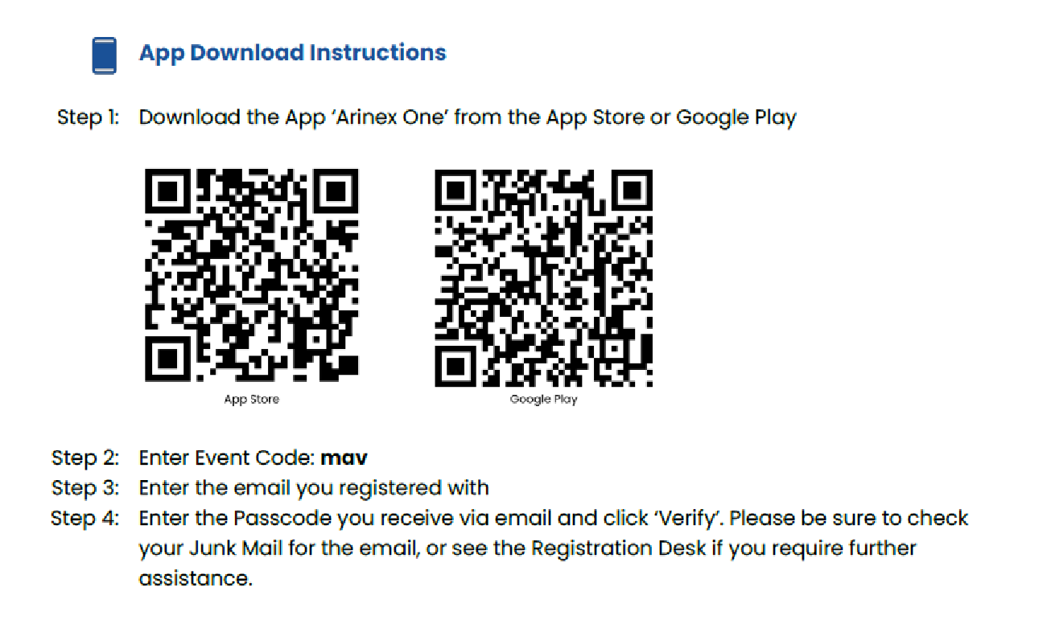
Event App

Slide 4
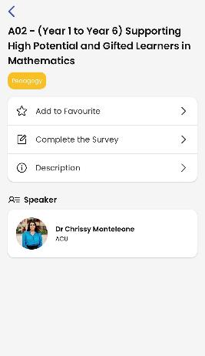
Be in it to WIN!

Slide 5
Session Overview
Background
BTC Overview
Strategies for collaboration and thinking
Try a task
Thin Slicing
The effects of BTC

Slide 6
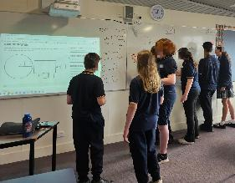
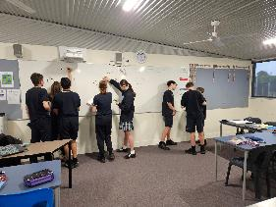
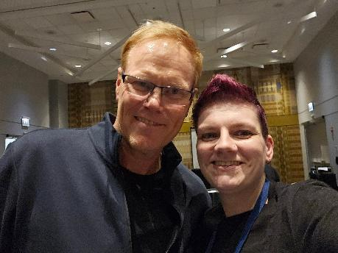
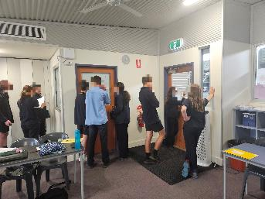
Background - A little about me and my students

Slide 7
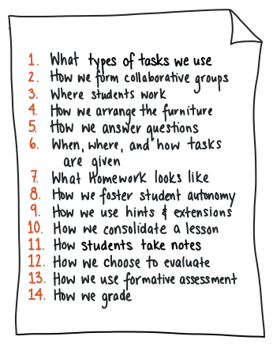
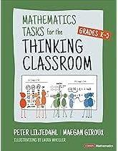
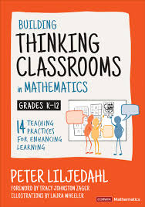
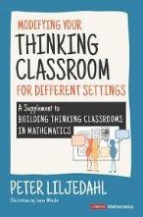
BTC Overview

Slide 8
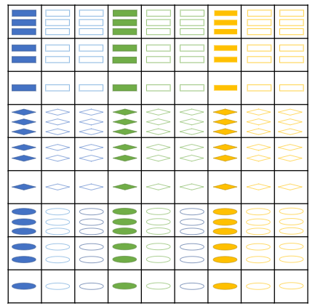
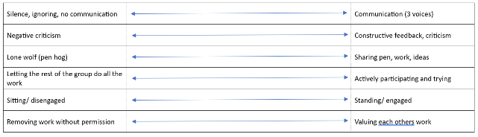
Strategies for collaboration and thinking
Visibly random groups
Build a collaboration rubric
Non Curricular Tasks
Only answer ‘keep thinking questions’
Value thinking over answer getting

Slide 9
Session Overview
Background
BTC Overview
Strategies for collaboration and thinking
Try a task
Thin Slicing
The effects of BTC

Slide 10
Task
Random groups
Study your ‘network’ and write a detailed description that can be used by another group to draw your network

Slide 11
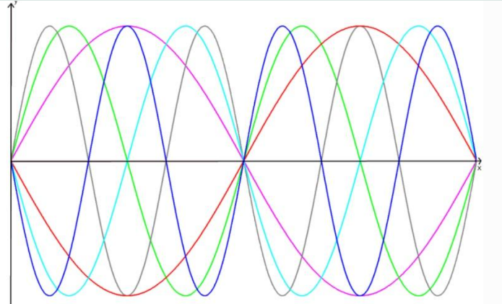
Other tasks I like
https://nrich.maths.org/problems/tangled-trig-graphs

Slide 12
Other tasks I like
Adding together a series of numbers
Starts with story about Gauss adding 1 to 100
https://www.nctm.org/Publications/TCM-blog/Blog/The-Story-of-Gauss/
Building to adding from any starting value with a common increase (see handout)

Slide 13
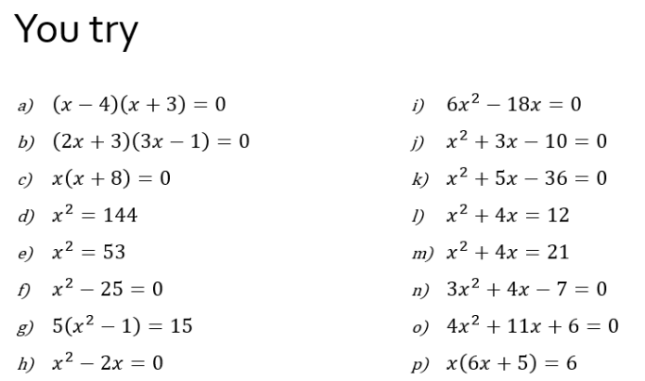
Thin Slicing
Most common question types
Change one thing at a time
Really need to understand progression
Have a low enough access point so students can experience success

Slide 14
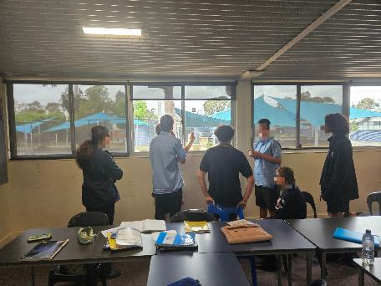
BTC in action
More engagement
More knowledge mobility
Improved results
Better communicators

Slide 15
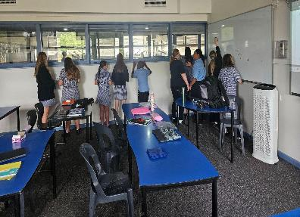
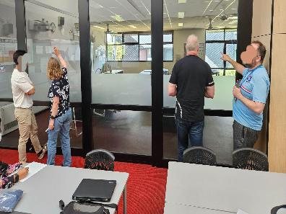
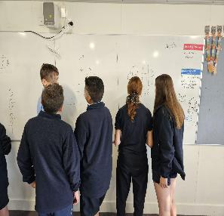
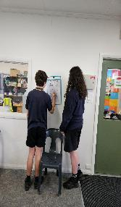
Questions??

Slide 16
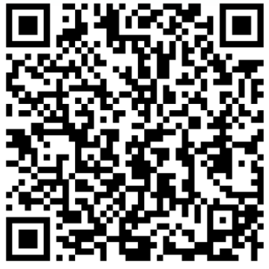
Event App
RESOURCES

Slide 17
Be in it to WIN!

